Slide 1
Rendlesham Revealed
Teaching Resources 1
What is Archaeology?
Archaeological techniques used to discover the royal Anglo-Saxon settlement at Rendlesham.
Approx. 1-2 hours
plus optional additional activities which could be individual lessons or part of the same lesson

Slide 2
This is an archaeology-themed lesson plan based on how the Anglo- Saxon settlement at Rendlesham was discovered. These activities and resources aim to inspire pupils’ curiosity to know more about the past. They are designed to support the teaching of the History curriculum in Key Stage Two. The resources enable children to develop an awareness of archaeological techniques and discoveries and how they can be used to build their understanding of people in the past. This collection has been devised as ‘ready to use’ lesson plans, to enable teachers to access a variety of historical sources looking at case studies while also focusing on a local study.
“Teaching should equip pupils to ask perceptive questions, think critically, weigh evidence, sift arguments, and develop perspective and judgement. History helps pupils to understand the complexity of people’s lives, the process of change, the diversity of societies and relationships between different groups, as well as their own identity and the challenges of their time.” History Programmes of Study. National Curriculum 2013.
All IMAGES ARE © SUFFOLK COUNTY COUNCIL

Slide 3
Historians
We are becoming historians!
A historian is someone who studies, questions and understands the past.

Slide 4
Our Learning
We are learning | how archaeology has revealed the Anglo-Saxon settlement at Rendlesham
We are doing this | by learning the techniques used by archaeologists and how they piece together what life was like in the past
So that we can | develop our understanding of Anglo-Saxon life and be able to explain some key characteristics of life at Rendlesham.
In order to | answer the question ‘How has archaeology revealed Anglo-Saxon Rendlesham?’

Slide 5
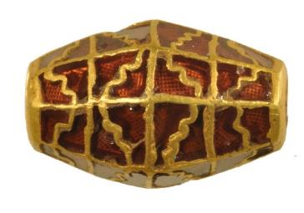
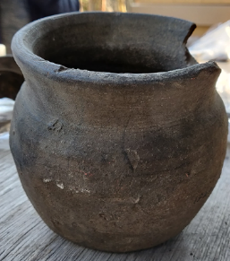
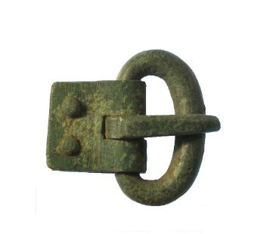
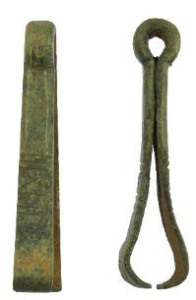
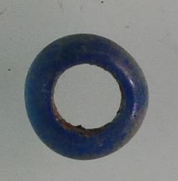
New terminology
Artefacts - artefacts are portable. They can be picked up and moved. Artefacts are objects that have been made or used by humans.
Bead
Pottery
Brooch
Tweezers
Buckle
Bead

Slide 6
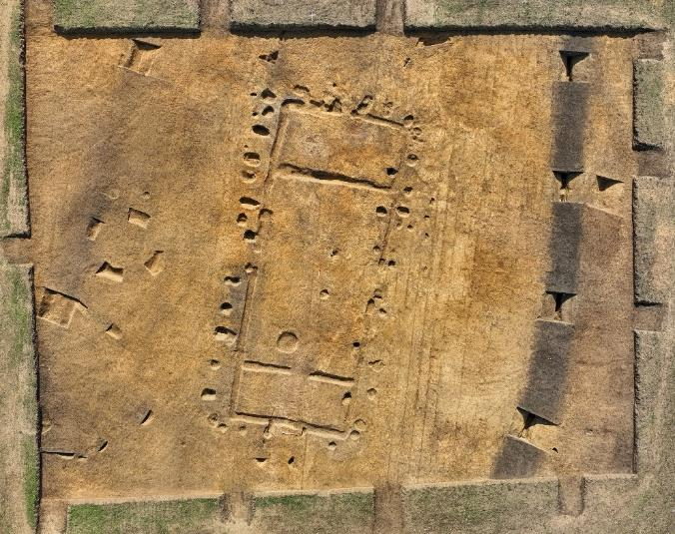
New terminology
Archaeological features – features are not portable. They are in the ground.
They are the remains of past activity, such as ditches and pits, or post holes from building remains.
Post holes and foundations
of a building
ditch
ditch
Drone photograph of archaeological remains excavated at Rendlesham
Photo by Jim Pullen

Slide 7
Archaeologist
Archaeologists are like detectives. They look for clues to understand our past. They do this by excavating under the ground or looking at the landscape.
They also study objects, this is often rubbish that people in the past have thrown away.

Slide 8
What is archaeology?
Archaeology is the study of the past using physical remains.
These remains can be features, buildings or any objects that people created, modified or used, and other remains such as animal bones from the meals eaten in the past.
They are studied by archaeologists to determine more about the people who lived in the past, at a certain place or time.
Archaeologists use a variety of techniques such as field walking, metal detecting and excavation to uncover features, artefacts and ecofacts.
Once these remains have been found, further analysis happens to understand more about their date or character.
Together all this information helps archaeologists to understand the past.

Slide 9
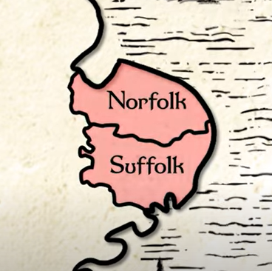
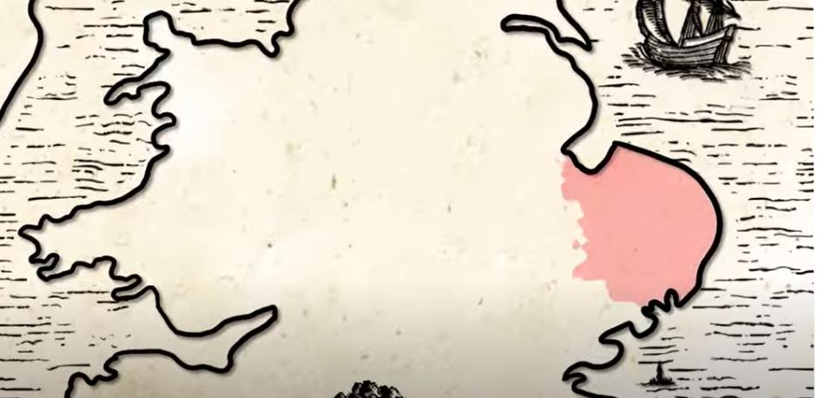
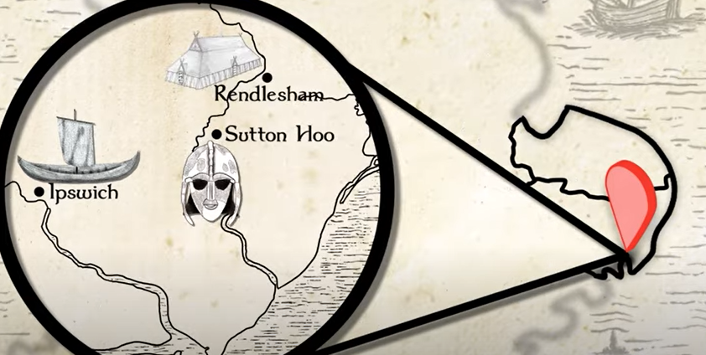
Anglo-Saxon Rendlesham
1,500 years ago, South-East Suffolk was part of an area known as the East Anglian Kingdom. This is now modern-day Norfolk and Suffolk.
The Anglo-Saxon period (also known as the early medieval period), refers to England between the 5th and 11th centuries (AD 410 – 1066).
Soon after the end of Roman Britain until the Norman Conquest in 1066
Archaeologists previously discovered the Anglo-Saxon princely burial ground at Sutton Hoo and the international trading port and town of Ipswich.
Now, archaeologists have also discovered the long-lost royal settlement of Rendlesham, where the East Anglian kings would have stayed.

Slide 10
Video: How has Archaeology Revealed Anglo-Saxon Rendlesham? (3 mins)
heritage.suffolk.gov.uk/rendlesham-teaching-resources

Slide 11
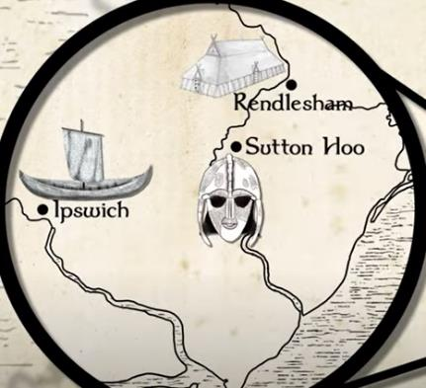
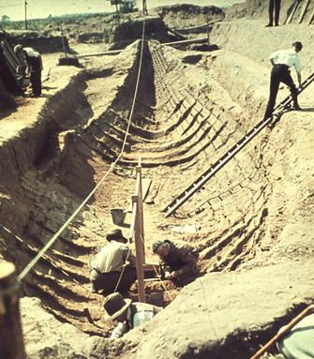
Finding Anglo-Saxon Rendlesham
First, archaeologists studied historical documents, aerial photographs and old maps. These gave clues of where to look.
A monk called Bede wrote the first history of England in the early 8th century (AD 731).
In this history he tells us that Rendlesham was the royal settlement where Aethelwold, King of the East Angles, stood sponsor (a Godparent) at the baptism of Swithelm, king of the East Saxons, sometime between AD 655 and 663.
There has been lots of speculation about the
exact location of this settlement, especially since the discovery of the Sutton Hoo ship burial by Basil Brown in 1939.
Excavating the Sutton Hoo ship burial in 1939

Slide 12
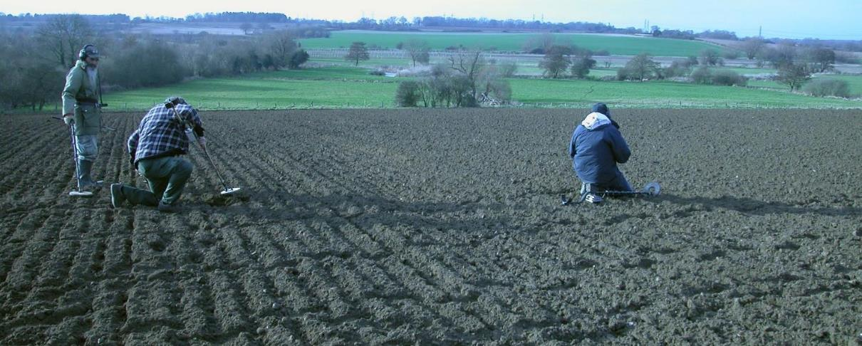
The First Discovery at Rendlesham
In 2007, the local landowner reported illegal metal detecting on his land. Suffolk County Council Archaeological Service was consulted and, with the landowners’ agreement, co-ordinated
a project to see what was being stolen.
From 2009 to 2014, a large archaeological survey took place, which identified the royal settlement. The results helped the archaeologists to understand the size of the settlement and how people living in the past used the land.
Metal detecting survey at Rendlesham

Slide 13
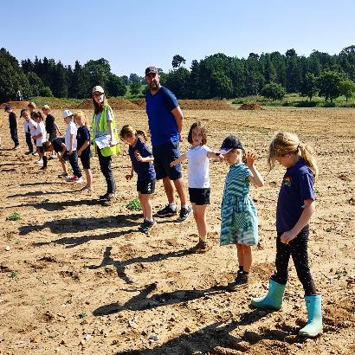
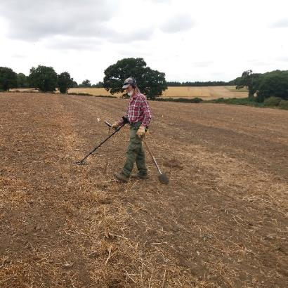
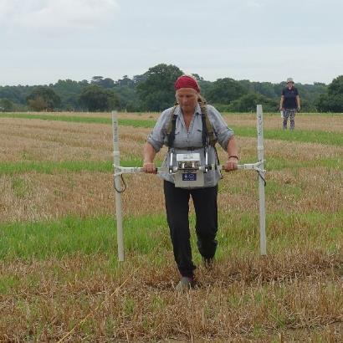
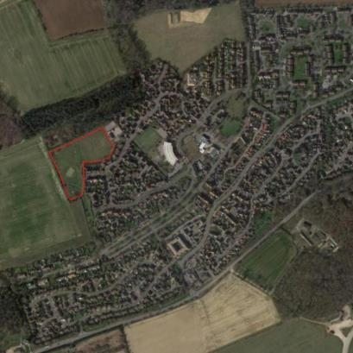
Archaeological Techniques
The techniques used to survey the land included:
Metal Detecting
Fieldwalking
Geophysics
Aerial Photography

Slide 14
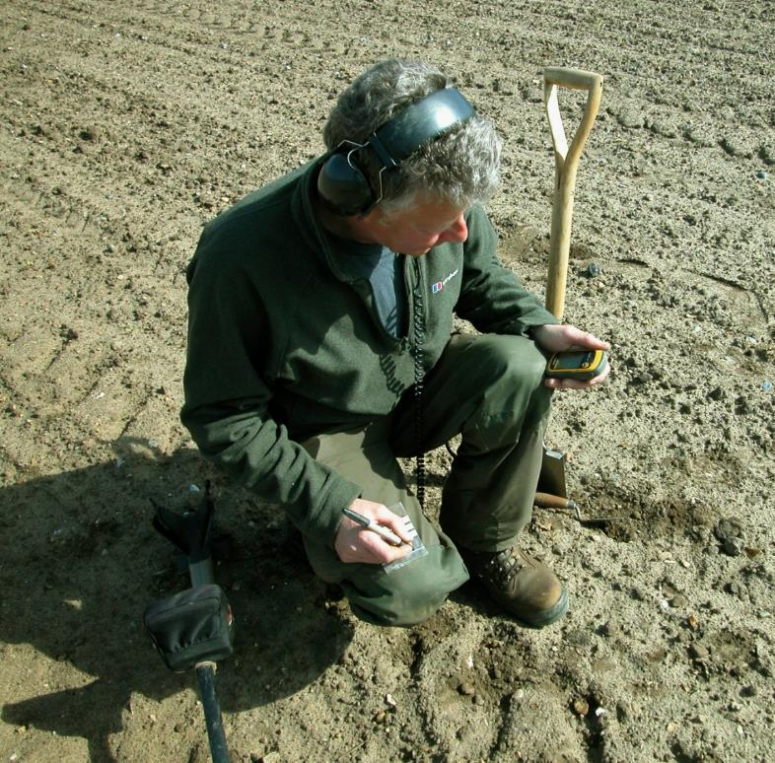
Metal Detecting
What is metal detecting?
A metal detector is a machine that finds metal objects in the top of the soil on a ploughed field.
The machine beeps when metal is found.
The person using the metal detector retrieves the object and places it in its own individual bag.
They use a handheld GPS device to record the precise location of where the object was found. This is called a Find Spot.
It is important to have permission from the landowner before metal detecting and to record any finds with the local Finds Liaison Officer (www.finds.org.uk).

Slide 15
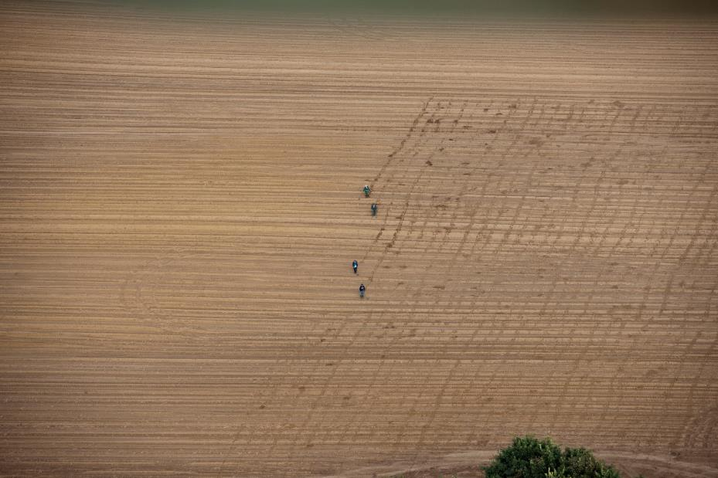
Look closely at this photo. What do you notice?
Metal detector users walk carefully and systematically across ploughed fields.
You can see in the photo how they are covering all of the field by walking in evenly spaced lines up and down the field.
Why do you think they are working in this way?
©Historic England
Metal detecting survey at Rendlesham

Slide 16
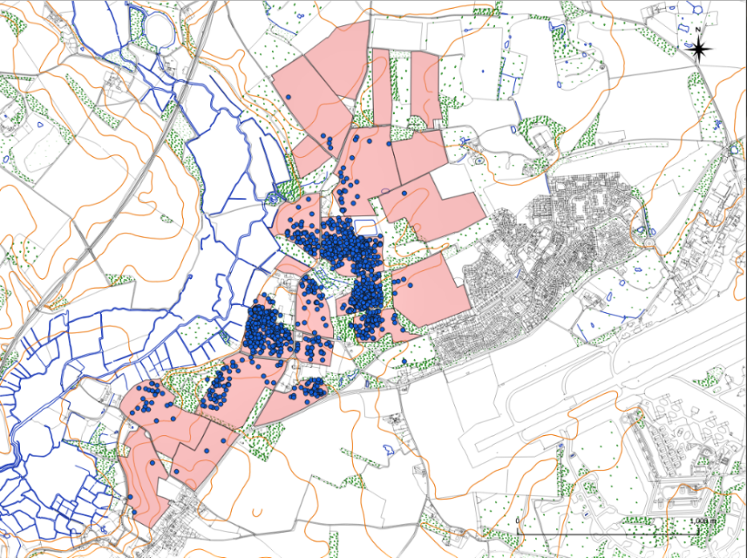
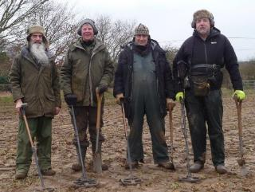
This map shows the fields that were metal detected (shaded in pink).
By working systematically, the metal detector users can be certain that nothing has been missed.
With this information the archaeologists can record all the find spots (blue dots) onto maps.
The maps show the density (how many) and the distribution (where) objects were found.
The archaeologists can then begin to look for patterns and concentrations of activity.
OS map © Crown Copyright. All rights reserved. Suffolk County Council Licence 100023395

Slide 17
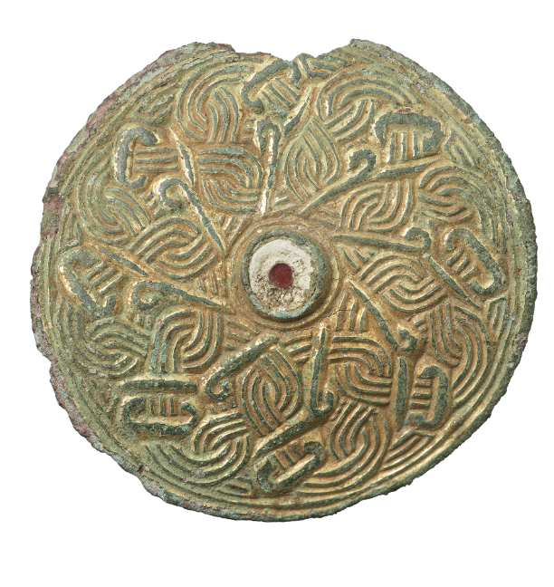
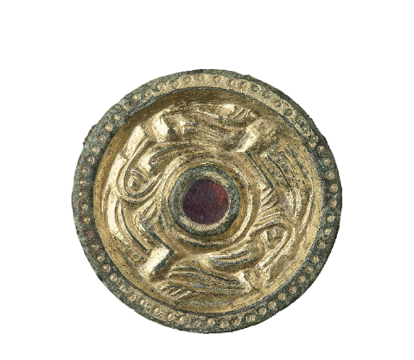
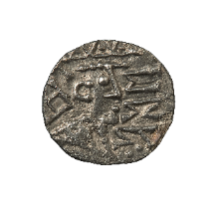
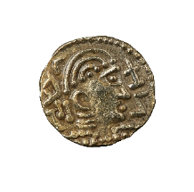
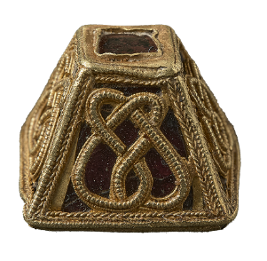
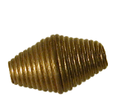
Metal Detecting: what objects did they find at Rendlesham?
The metal-detecting survey found over 5,000 objects at Rendlesham from the Stone Age to Tudor periods. These include Bronze Age axes used 4,000 years ago, 2,000 year old Roman brooches, and medieval silver coins used 600 years ago.
Over 1,000 objects were Anglo-Saxon used 1,000 to 1600 years ago. Many of these objects were made of precious materials like gold or silver, so they must have belonged to wealthy individuals who visited the royal settlement.
Gold and Silver Coins
Gilded copper-alloy
Disc-shaped Brooch with garnet setting
Gold and Garnet
Beads
Gold and Garnet Fitting
for a Sword Scabbard
Gilded copper-alloy fitting
for a Horse-Harness

Slide 18
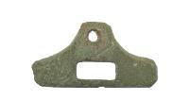
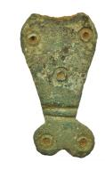
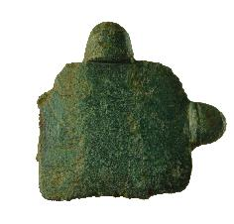
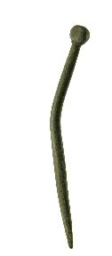
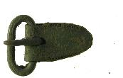
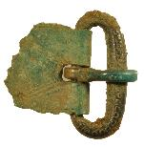
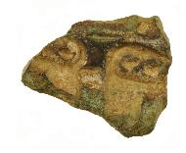
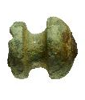
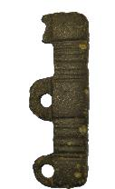
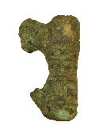
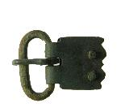
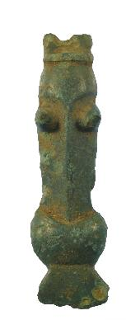
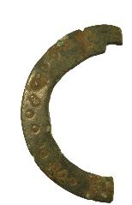
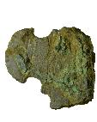
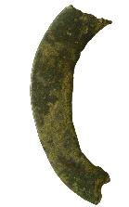
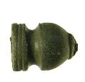
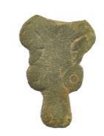
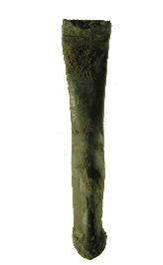
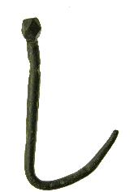
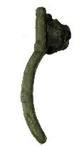
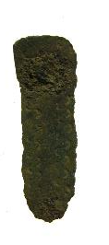
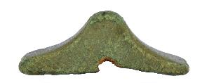
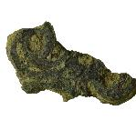
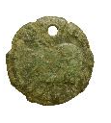
But most objects look like this and were used by ordinary people.
These are made of copper alloy (bronze), and include objects like buckles, pins, bag-catches
0
10
m
20

Slide 19
5-minute Activity
Look closely at the pie charts about metal detecting on the next page.
What do they tell us about Rendlesham?
Work collaboratively to discuss this question.
Think of 2 facts to tell the class.

Slide 20
Pie Charts: metal detected objects shown by period
Rendlesham
All Suffolk

Slide 21
Pie Charts: What do they tell us?
There are five-times more Anglo-Saxon objects at Rendlesham than usually found in the rest of Suffolk. This tells us that Rendlesham was a major focus of Anglo-Saxon/early medieval activity.
There are fewer Roman objects at Rendlesham compared to the rest of Suffolk – but there are still quite a few, indicating some settlement activity was present in the area.
There is a similar amount of medieval and post-medieval objects for both Rendlesham and Suffolk.

Slide 22
Fieldwalking
What is fieldwalking?
Fieldwalking is the collection and recording of artefacts found on the surface of a ploughed field. Ploughing brings the objects to the surface from their archaeological context.
This technique is very simple and useful to assess the archaeological potential over a large area. It can help to indicate what buried archaeological remains might be hidden underneath the soil.
People walk systematically in lines across the field, usually covering a 30m square at a time. The squares are numbered so we know exactly where the artefacts were found.

Slide 24
Geophysical Survey
What is Geophysics?
A machine is used to ‘take a picture’ of what is buried underneath the ground.
It is a useful technique to explore large areas quickly. It can show if the ground has been disturbed in the past, for example if someone has dug a ditch or a pit.
This only tells you if something is there. Archaeologists then need to excavate a sample of any possible features to confirm and work out their date and character.

Slide 25
modern pipe
The most commonly used type of geophysics is magnetometry.
The machine sends a signal into the ground to measure the magnetic response of the soil and record any differences.
In this picture you can see the results.
The light grey is the normal soil.
The dark grey is where the ground has been disturbed, for example if someone dug a ditch or pit.
The white is possible metal or burnt material.
pits
ditches
pits

Slide 26
Aerial Photography
What is Aerial Photography?
Aerial photos are taken from above looking down onto the ground.
Usually, an aeroplane or a drone is used to photograph large areas.
Aerial photographs are examined for cropmarks.
Aerial Photo of Rendlesham village

Slide 27
Cropmarks are visible as different colours when the crops, like wheat, grow in archaeological features.
Why is this?
A feature, like a filled in ditch, is deeper and holds more moisture, so the crops grow taller.
A feature, like a buried brick wall or floor, can cause the crops to grow less or not at all.
Fornham All Saints – circular ring ditches and enclosure ditches
Stoke Church

Slide 28
You have learned about the different archaeological survey techniques: metal detecting, fieldwalking, geophysics and aerial photography.
Archaeologists use one or all of these techniques to build up a picture of what archaeology may be hidden in the area.
This helps archaeologists to decide exactly where they want to excavate to answer specific questions about a site.
Excavation is the next stage to investigate the archaeology further.

Slide 29
Excavation
What is Excavation?
Excavation is the process of digging to remove soil to uncover archaeological features and objects.
A mechanical digger can be used to expose the features over a large area called a ‘trench’.
Archaeologists then hand-excavate the features using a trowel. Once the archaeology is fully excavated it has been destroyed and so it needs recording carefully.
The physical remains found in the features give information about the date and character of the features. Excavation also allows archaeologists to find out how well the buried archaeology has survived.
360-digger opening the trench
Hand-excavating the features

Slide 30
During the recent community excavations at Rendlesham, 10 trenches were excavated over 3 years. More than 600 volunteers from the local community were involved, including young people from local primary schools.

Slide 31
Look at this photo of a trench. What do you see?
There are different colours in the soil. The lighter, orange-coloured soil is the natural soil. The dark grey/black soil are the archaeological features – these are a different colour because organic material has decomposed and filled in the features.
Archaeologists have excavated
sections of each feature.
pits
Ditch – continues around the perimeter of the royal settlement
Foundations of buildings that held wooden walls
Trench at Rendlesham, after all the features were excavated
Photo by Jim Pullen
Post holes of a building where wooden posts would have been

Slide 32
Challenge Activities
The following slides contain some challenge activities you might like to try with your class building on the skills covered in these slides.

Slide 33
Challenge Activity: Aerial Photography
Using a camera take photos in the classroom of everyday objects from above to give an aerial view?
Are any of the objects difficult to identify?
Experiment with taking photos of different size objects.

Slide 34
Challenge Activity: Archaeological Features
Try to recreate the post holes of a building using soil outside or some clay.
Use small sticks to recreate the posts.
Record what you can see when you remove the sticks. You could sketch an image of this or you could take an aerial photograph.

Slide 35
Challenge Activity: Fieldwalking
Can you walk systematically in a line as a group across the school grounds and collect litter?
Other people’s rubbish is what archaeologists use to learn about lives in the past.
What does rubbish around your school tell you?

Slide 36
Challenge Activity: Archaeology Skills
How many different types of jobs/skills can you think of that people working within archaeology have?
Have a look back through the slides and write a list.
How many have you thought of?
Compare your list with a friend.

Slide 37
Challenge Activity:
Being an Archaeologist
Would you like to be an archaeologist?
What aspect interests you the most and why?

Slide 38
Inference and Deduction
What does the artefact tell you for certain?
What can you infer from the artefact?
What does the artefact not tell you?
What other questions do you have?
Challenge Activity:
Pocket Museum
This activity builds excitement around handling artefacts and helps pupils to understand what objects can tell us about the past.
It is a technique for representing the idea that objects can tell stories.
It opens the conversation that archaeologists use objects to learn about the lives of people from the past.
Ask the pupils to:
Choose some objects from your classroom or your school bag/ tray.
What do these items tell us about you? Can you label them? What information do you need to include?

Slide 39
Further Resources
Visit heritage.suffolk.gov.uk/rendlesham to find more resources including:
Virtual 360° exhibition tour
Videos on Anglo-Saxon life
Online book
Blogs and articles

