Slide 1




Rendlesham Revealed
Teaching Resources 2
Exploring artefacts, material types and what survives.
What can archaeologists learn about the settlement and people living at Rendlesham?
Approx. 1-2 hours
plus optional additional activities which could be individual lessons or part of the same lesson

Slide 2
This is an archaeology-themed lesson plan based on how the Anglo- Saxon settlement at Rendlesham was discovered. These activities and resources aim to inspire pupils’ curiosity to know more about the past. They are designed to support the teaching of the History curriculum in Key Stage Two. The resources enable children to develop an awareness of archaeological techniques and discoveries and how they can be used to build their understanding of people in the past. This collection has been devised as ‘ready to use’ lesson plans, to enable teachers to access a variety of historical sources looking at case studies while also focusing on a local study.
“Teaching should equip pupils to ask perceptive questions, think critically, weigh evidence, sift arguments, and develop perspective and judgement. History helps pupils to understand the complexity of people’s lives, the process of change, the diversity of societies and relationships between different groups, as well as their own identity and the challenges of their time.” History Programmes of Study. National Curriculum 2013.
All IMAGES ARE © SUFFOLK COUNTY COUNCIL

Slide 3
Historians
We are becoming historians!
A historian is someone who studies, questions and understands the past.

Slide 4
Our Learning
We are learning | how archaeology has revealed the Anglo-Saxon settlement at Rendlesham
We are doing this | by learning the techniques used by archaeologists and how they piece together what life was like in the past
So that we can | develop our understanding of Anglo-Saxon life and be able to explain some key characteristics of life at Rendlesham.
In order to | answer the question ‘How has archaeology revealed Anglo-Saxon Rendlesham?’

Slide 5
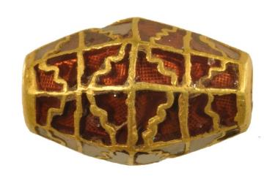
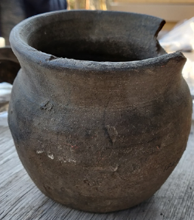
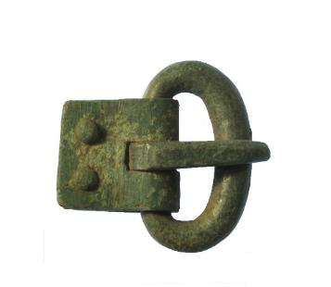
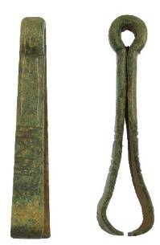
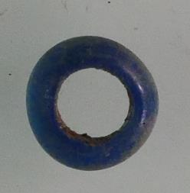
New terminology
Artefacts - artefacts are portable. They can be picked up and moved. Artefacts are objects that have been made or used by humans.
Bead
Pottery
Brooch
Tweezers
Buckle
Bead

Slide 6
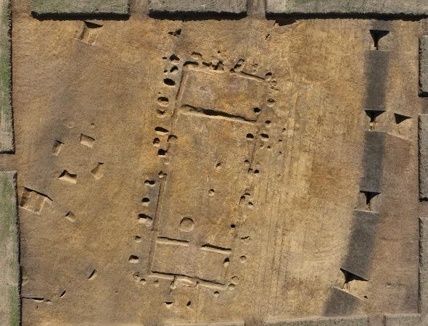
New terminology
Archaeological features – features are not portable. They are in the ground.
They are the remains of past activity, such as ditches and pits, or post holes from building remains.
Post holes and foundations
of a building
ditch
ditch
Photo by Jim Pullen
Drone photograph of archaeological remains excavated at Rendlesham

Slide 7
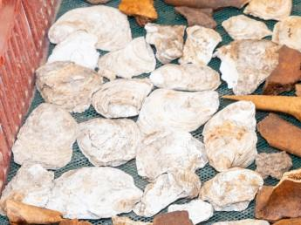
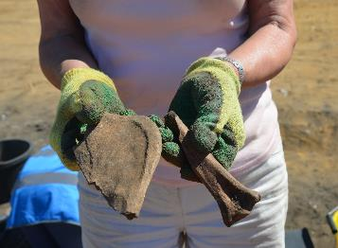
New terminology
Ecofacts - ecofacts are natural objects that have been modified by human use. This could include animal bone that shows signs of butchery (cut with a knife) or oyster shells that were used for food.
Oyster Shell
Animal bone

Slide 8
Archaeologist
Archaeologists are like detectives. They look for clues to understand our past. They do this by excavating under the ground or looking at the landscape.
They also study objects, this is often rubbish that people in the past have thrown away.

Slide 9
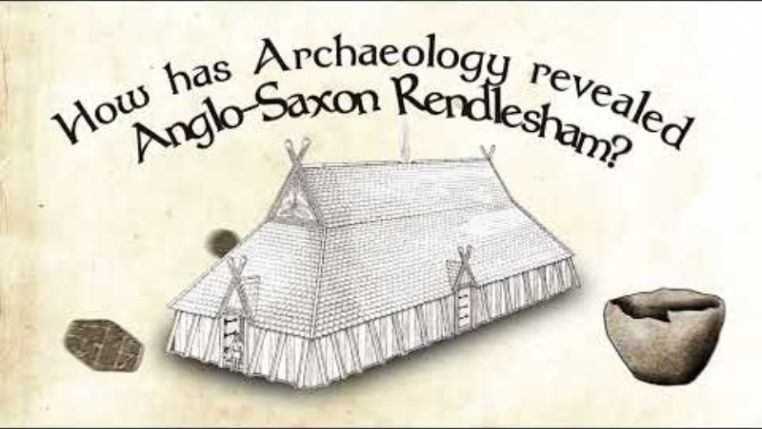
Video: How has Archaeology Revealed Anglo-Saxon Rendlesham? (3 mins)
heritage.suffolk.gov.uk/rendlesham-teaching-resources

Slide 10
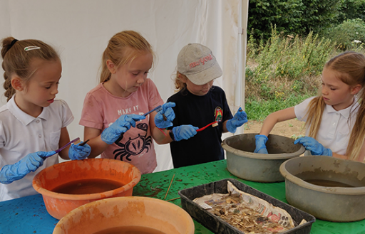
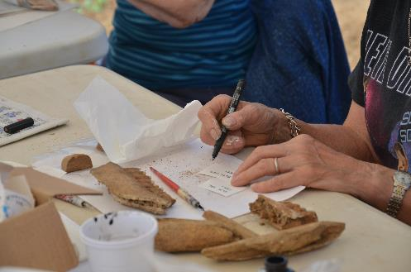
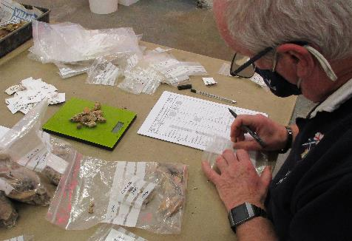
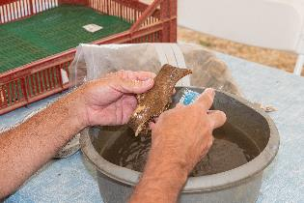
Finds Processing
What happens to the artefacts after archaeologists find them?
Archaeologists find artefacts when they are excavating, fieldwalking or metal detecting. Every single object that is excavated (apart from metal) must be washed, left to dry, labelled and counted. We don’t wash metal because it will rust.
This process is really important as archaeologists check the objects and sort them for further clues. A person with even more specialist knowledge will then examine and analyse the objects. The artefacts are then conserved and stored carefully in an archive.

Slide 11
Artefacts and Materials
What can artefacts tell us?
Archaeologists examine artefacts to learn more about the people who lived in the past.
Artefacts can tell us about the technology and the materials people used. They also give clues about the wealth, culture, beliefs, number of people, and mobility i.e whether any artefacts had arrived from different areas of the country or the world through trade or migration.
Artefacts are often objects that have been discarded or thrown away as rubbish when the object became broken and was no longer fixable. Sometimes objects were just simply dropped and lost. Objects are also buried deliberately such as in rubbish pits, or as grave goods.

Slide 12
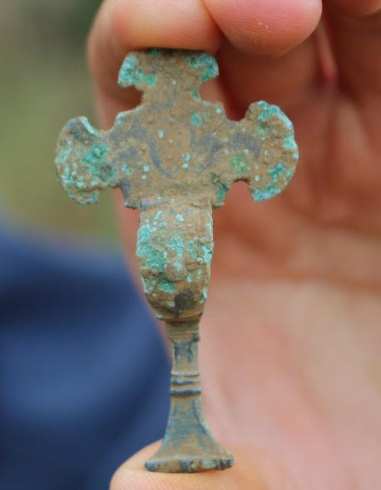
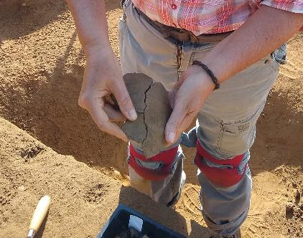
Artefacts are made of different materials – some of these survive better than others.
Some artefacts are very well preserved. This means that although the object may have some damage, it is possible to imagine and work out the original shape, design and purpose of the object.
Metal objects are often well preserved, especially gold and silver. Copper alloy (bronze) and iron objects survive but they can corrode (become damaged).
Some materials like wood or textile however
rot away entirely.
Brooch
Pottery

Slide 13
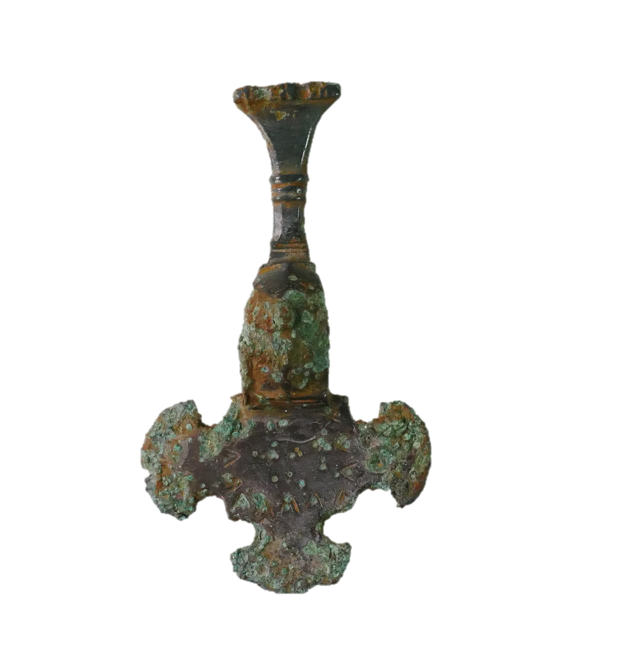
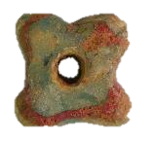
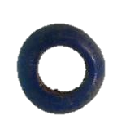
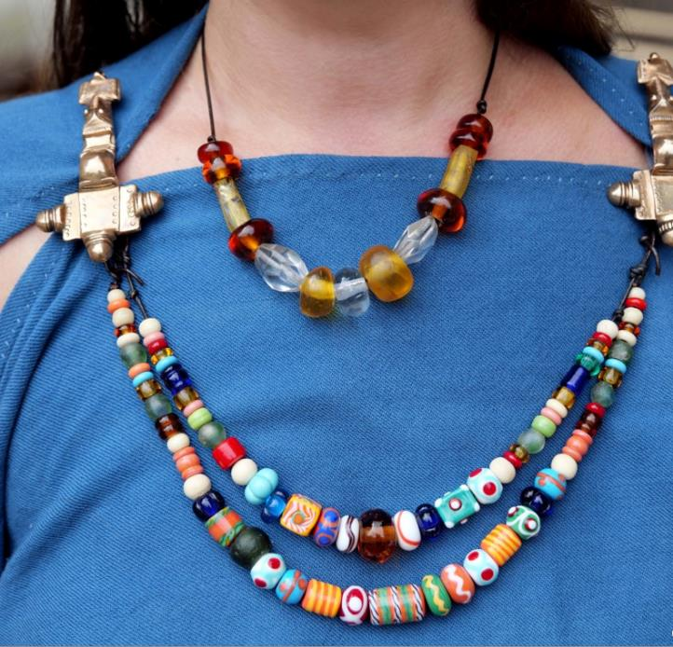
Most of the metal objects found at Rendlesham were jewellery or dress fasteners, such as brooches, pins and buckles, collectively called dress accessories.
59% of objects were dress accessories
Mainly of 5th-7th century date
7.5% are high status objects
Objects found at Rendlesham
Dress accessories can help reveal:
Costume changes through time
Cultural identities
Inter-regional connections
Social differentiation and the potential economic status of their owners. Rich or poor.
An elite presence; objects of precious metal
Replica objects

Slide 14

5-minute Activity
horn | leather | glass
fabric | bronze | pottery
wood | iron | gold
silver | bone | flint
Here are some different types of materials that people used in the past.
What objects do you think people made using these materials?
Discuss as a class or in small groups.

Slide 15
5-minute Activity – Example Answers
horn | leather | glass
fabric | bronze | pottery
wood | iron | gold
silver | bone | flint
Horn – drinking vessel/cup
Leather – shoes, bag, belts
Glass – bead, vessel
Fabric – clothing
Bronze – brooch, coins, pins, buckle
Pottery – bowls, pots for cooking
Wood – houses, handles for tools
Iron – knife, swords
Gold and silver – jewellery, coins
Bone – combs, pins, needles
Flint – tools (arrowheads, hand axes, scrapers)

Slide 16
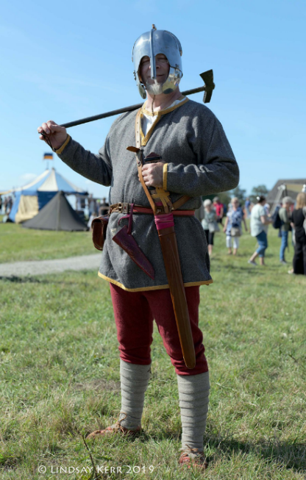
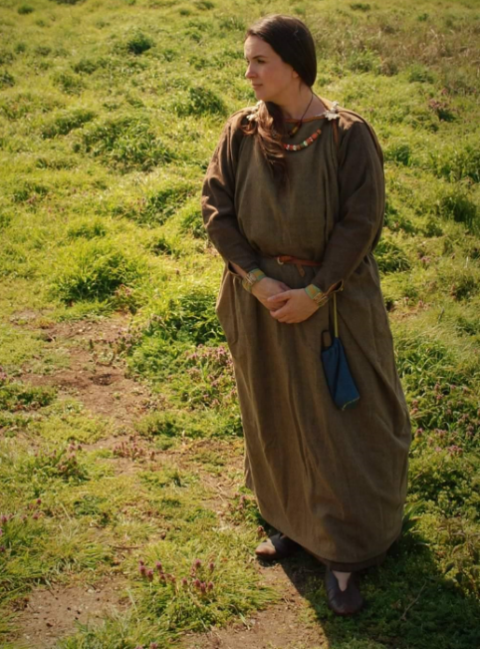
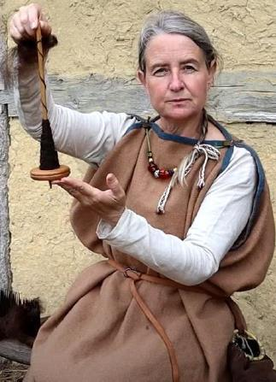
5-minute Activity
The Anglo-Saxon (or early medieval) period was 1,600-1000 (5th-11th centuries) years ago.
Look at these photos.
What objects do you think would survive?
Discuss as a class or in small groups.
© of Wulfheodenas

Slide 17


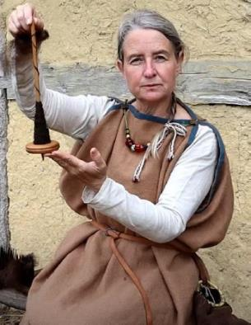
5-minute Activity
Example Answers
Iron Helmet
Iron axe head
Iron sword
Bronze Belt buckle
Gold or silver Coins
Glass or ceramic beads
Bronze brooches
Gold or silver Coins
Bronze sleeve clasps (which are used like buttons)
Bronze buckle
Glass or ceramic beads
Bronze brooches
Bronze buckle
© of Wulfheodenas
Materials such as fabric (wool), wood, leather are not likely to survive, they will rot away. Sometimes wood or leather can survive in very wet bog-like conditions. In these pictures, the clothing, wooden axe-handle, leather belt, shoes, purse and sword-scabbard are unlikely to survive.

Slide 18
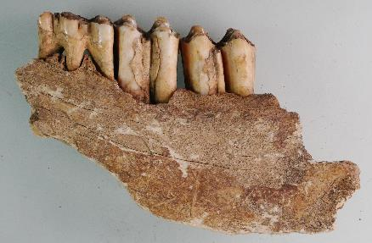

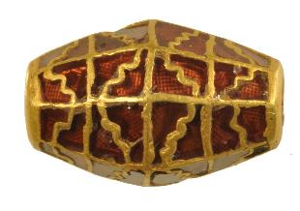
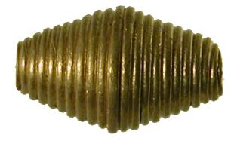
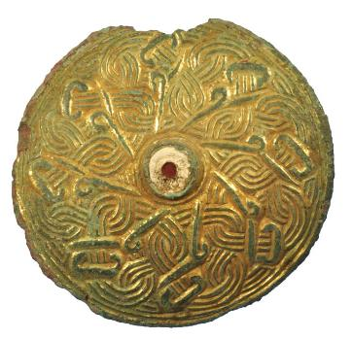
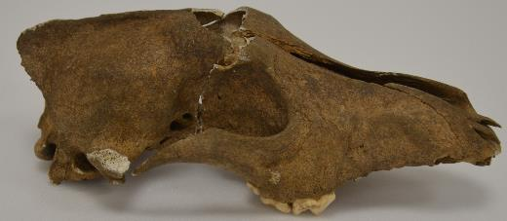
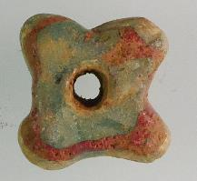
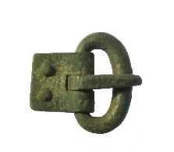
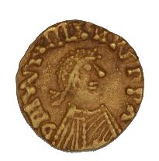
5-minute Activity
These objects were all found at Rendlesham.
Why have they survived? Think about what are they made of?

Slide 19
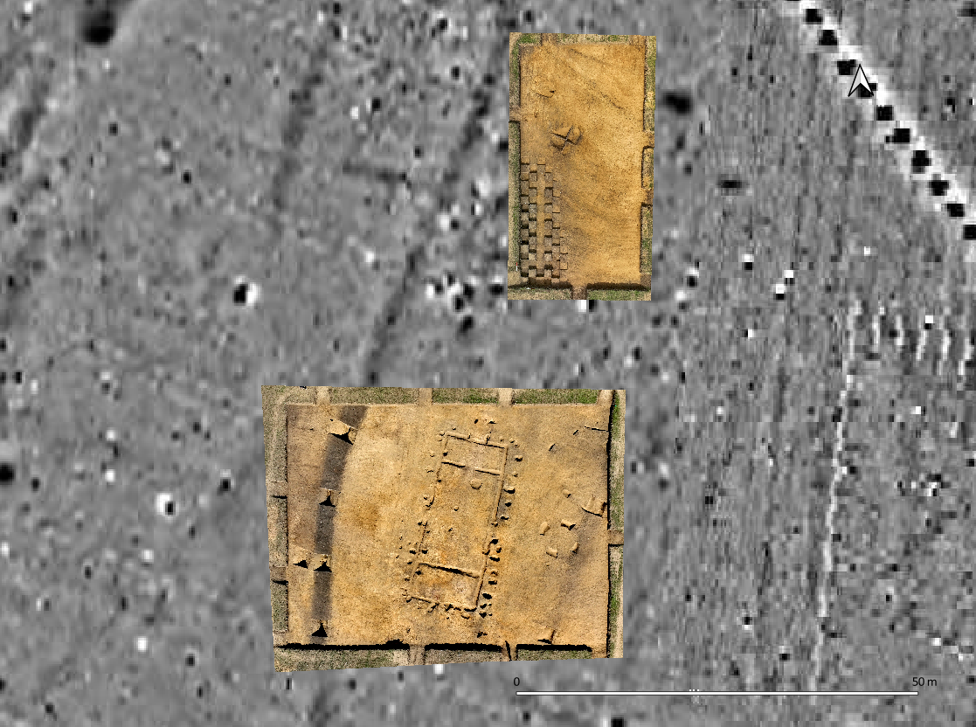
It’s All About Rubbish
Archaeologists look for clues to answer lots of questions about life in the past.
One of the most telling sources of information is what people threw away.
What can archaeologists learn by looking in the Anglo-Saxon rubbish dumps at Rendlesham?
Here are the rubbish dumps at Rendlesham (in the top trench) being excavated methodically in squares. They are not far from the great hall (in the bottom trench).
In the rubbish dumps, archaeologists found broken pot, butchered animal bones and oyster shells amongst other discarded or broken artefacts like pins and brooches.
Rubbish dump
Boundary Ditch
Great hall
Boundary Ditch

Slide 20
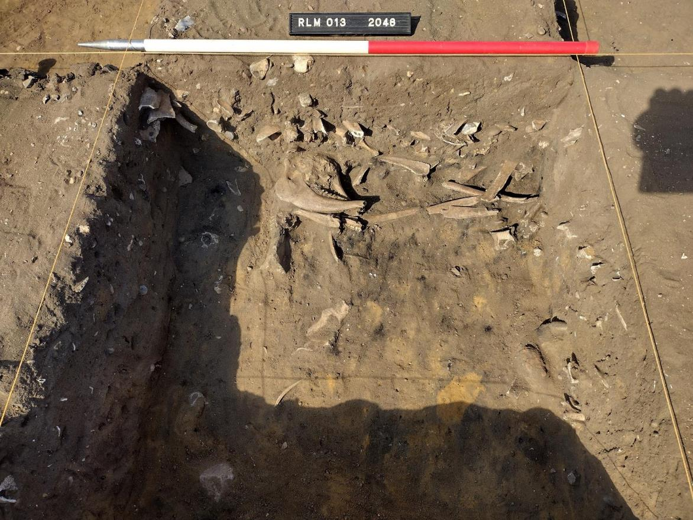
Over 150kg of animal bone was found in the rubbish dump.
Archaeologists believe this is the remains of many feasts held over many years by the wealthy people living at or visiting Rendlesham.
They were eating a lot of beef and pork.
Archaeologists also know that they kept large hunting dogs who were also very well fed!
The rubbish dump at Rendlesham under excavation

Slide 21
5-minute Activity
Let’s think about rubbish!
What would your bin at home tell us about you and your family?
Work collaboratively to discuss what you think an archaeologist could discover!

Slide 22
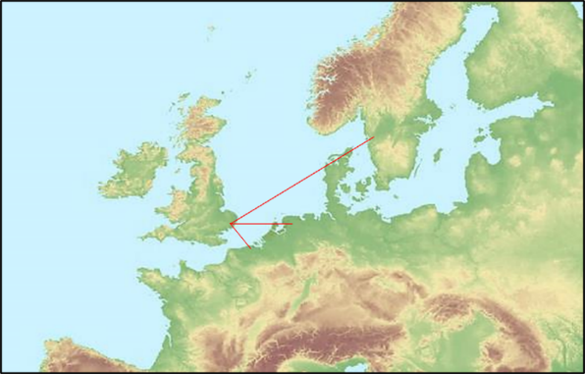
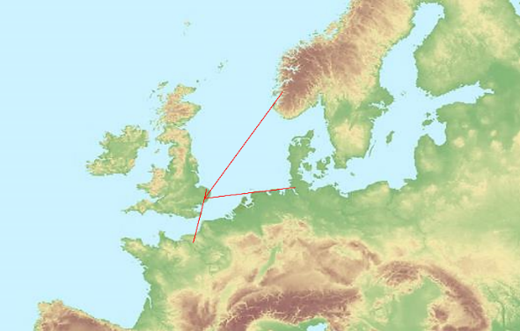
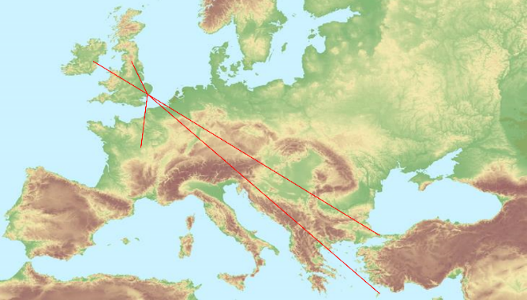
Where in the world?
By looking at the artefacts, archaeologists can work out who lived or visited a place.
At Rendlesham, people from all over the world, of native, continental and mixed descent would have come together to settle and trade. Artefacts that have been found show evidence of trading from different areas of the United Kingdom, Europe (France, Belgium, Netherlands, Germany and southern Scandinavia) and across the world (Byzantium now Istanbul, Sri Lanka or India.)
Rendlesham: Reach of Elite Networks
420–470
470–570
570–650

Slide 23
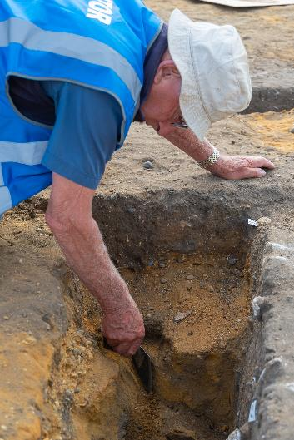
The Great Hall
What survives in the ground?
Materials such as wood rots away and leaves impressions in the ground.
Archaeologists can see these impressions in surveys or when they excavate the features and they can see them as different colours in the soil.
At Rendlesham, archaeologists discovered the foundation of a large hall that was once made of timber (wood).
By Jim Pullen

Slide 24
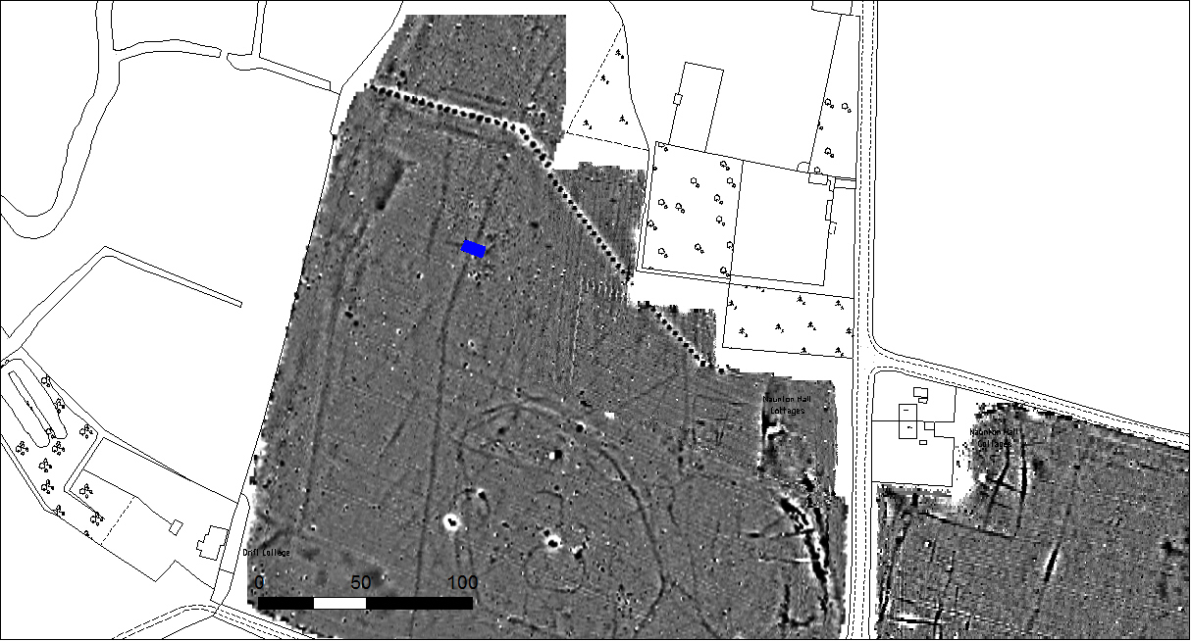
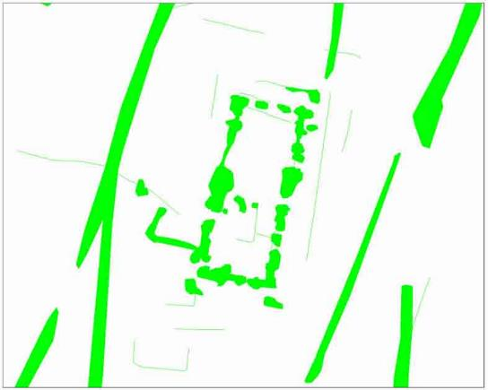
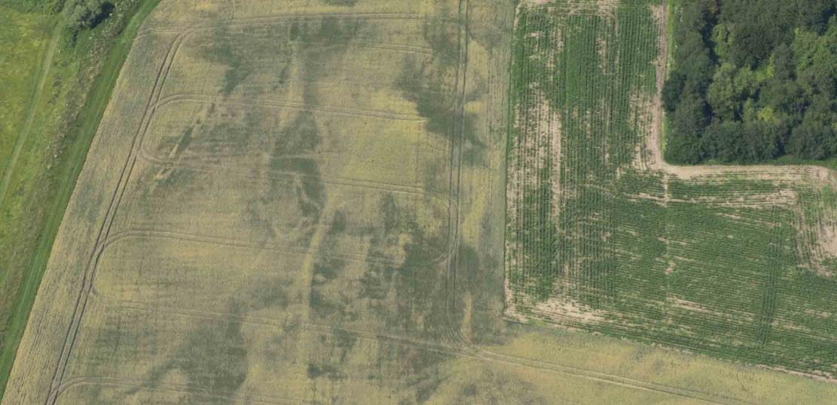
Transcription of Aerial Photograph
Geophysical Survey
Aerial photography combined with the geophysical survey showed the foundations of a large hall.
Aerial Photograph

Slide 25
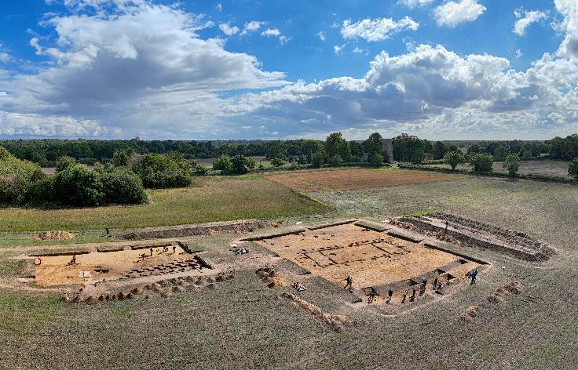
The hall was excavated in 2022. The wooden structure has rotted away over time.
Archaeologists could only see the different colours of the soil where the holes for wooden posts and foundation trenches for wall planks once were.
After the hall foundations were fully excavated, archaeologists could begin to imagine the size
and design of the building that once stood there 1,400 years ago.
By Jim Pullen
Drone photographs of the excavations at Rendlesham in 2022 of the trenches (top) and close up of the hall (left)
By Jim Pullen

Slide 26
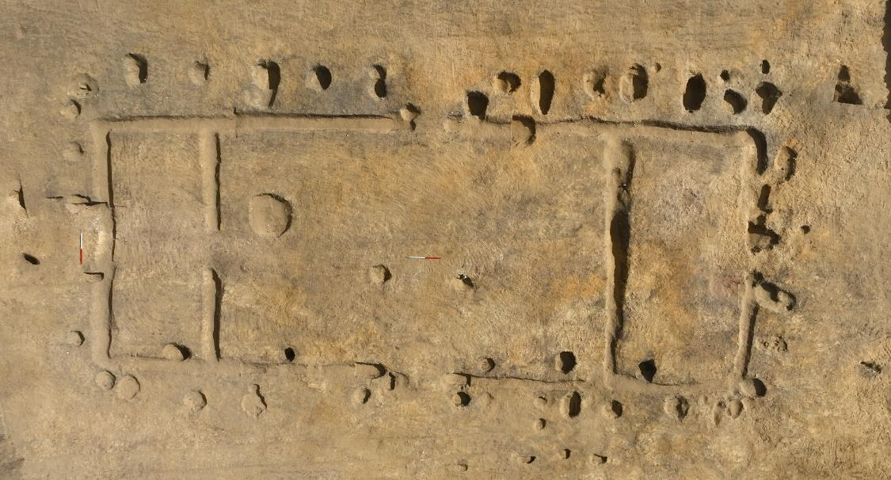
The hall measured 23m long by 11m wide, with an internal floor area of 20m by 8m.
This is five times larger than the area of a normal dwelling house of this period.
You can see there was a main central hall (12m x 8m in size), with two smaller chambers at either end separated by internal partitions.
Drone photograph close up of the hall
By Jim Pullen

Slide 27
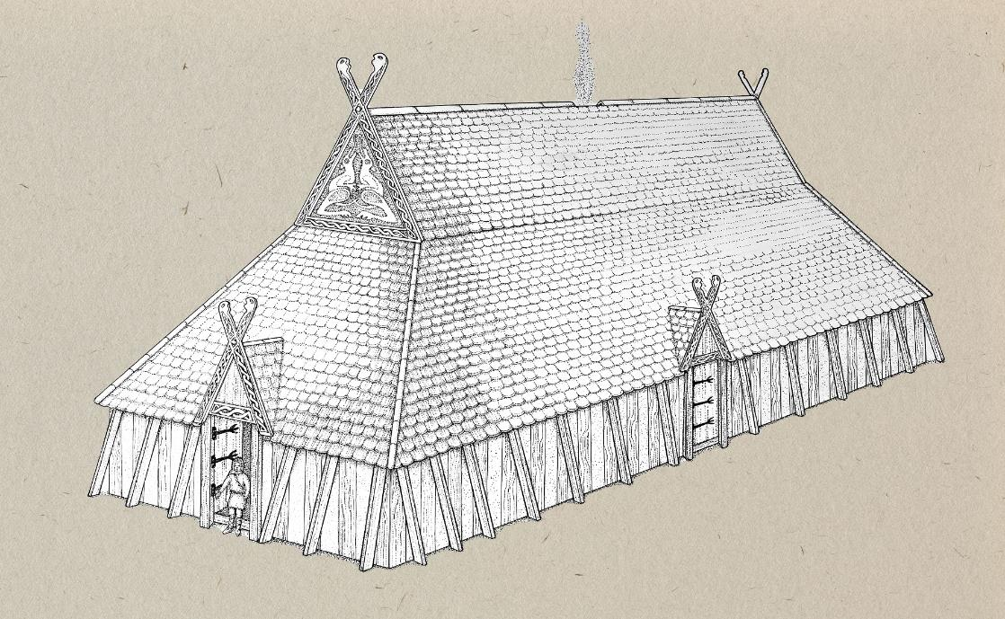
During the excavations, fragments
of white material, possibly plaster, were recovered from the foundation features.
Using our imagination, it is entirely possible that the hall may have been painted, and that the main timbers around the doors and gables could have been decoratively carved.
By Donna Wreathall
Artist illustration of the hall at Rendlesham based on the excavated remains

Slide 28
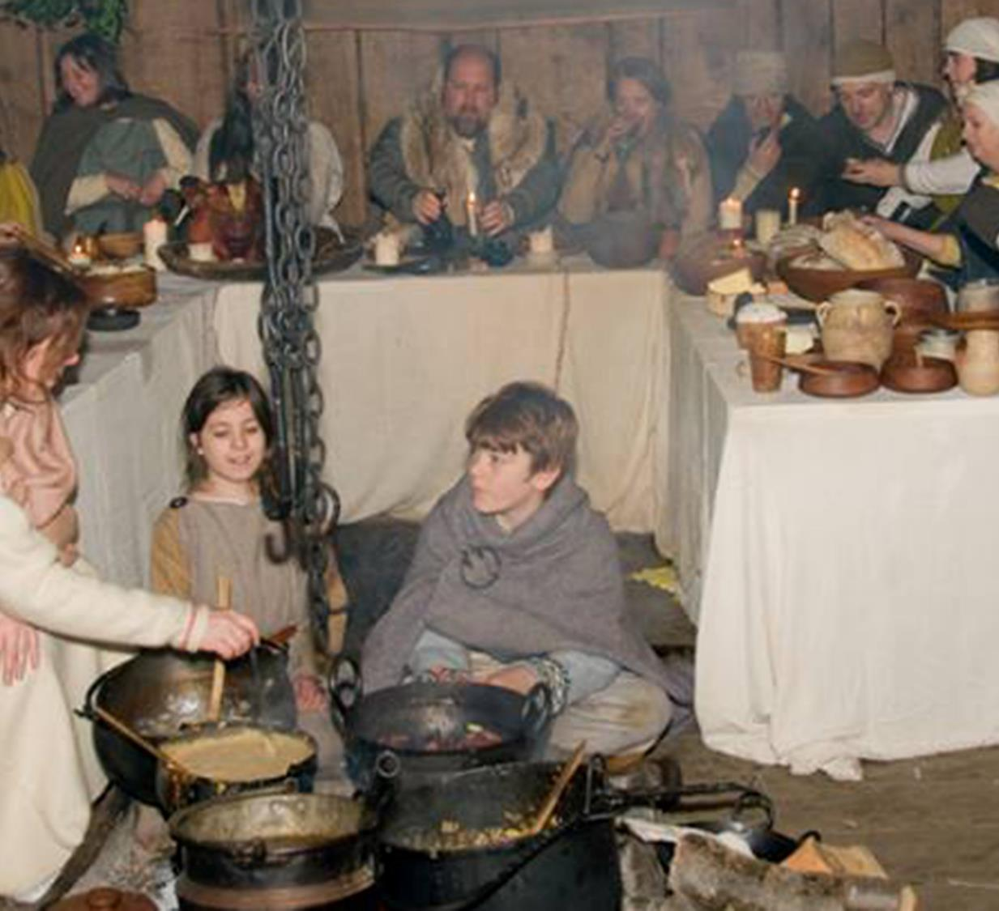
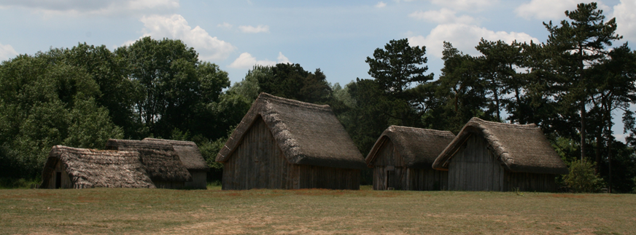
With the information gathered archaeologists can begin to imagine what life would have been like within the houses and halls on the settlement.
Reconstructed houses at West Stow Anglo-Saxon Village

Slide 29
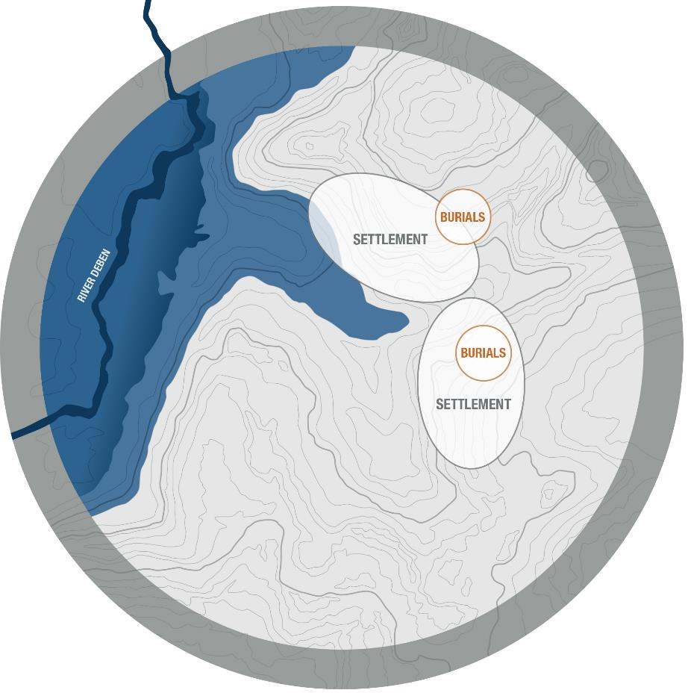
In the 5th century (AD 400-570) a settlement was established at Rendlesham which grew to cover 18 hectares (the area of 30 football pitches).
The settlement was made up of many family farmsteads, with timber houses and with huts used as workshops.
People grew wheat and barley, and kept cattle, sheep and pigs.
The artefacts also suggest the presence of warriors with connections to Southern Scandinavia.

Slide 30
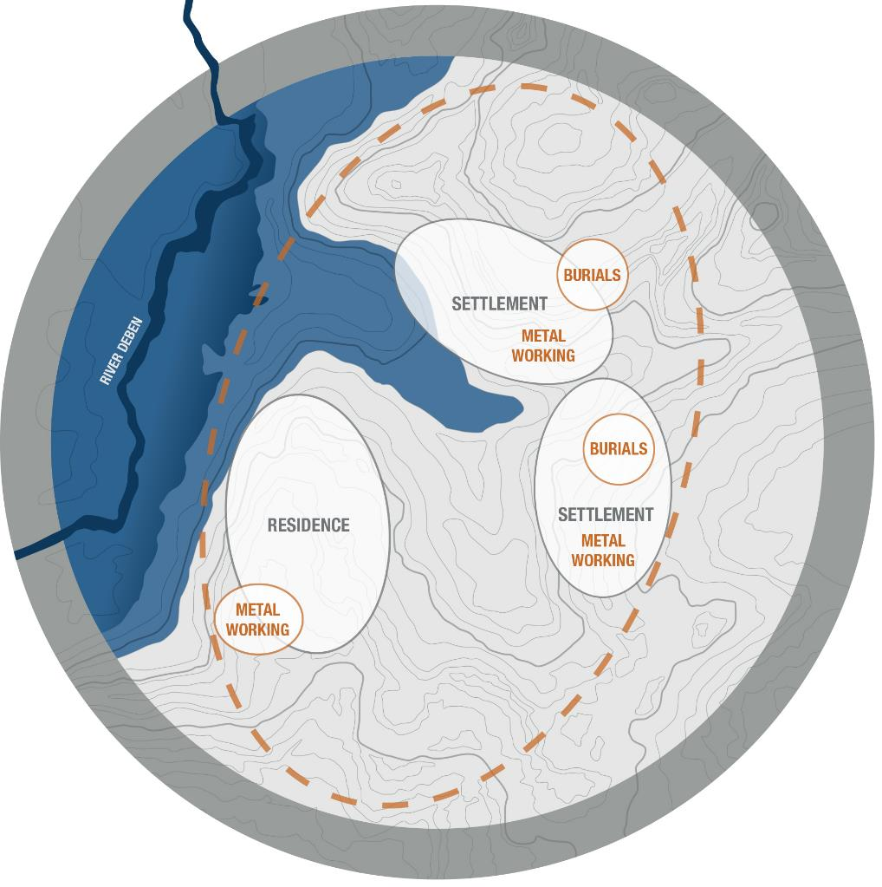
The settlement at Rendlesham grew and became an important royal centre in the later 6th and 7th centuries (AD 570-720).
It would have been a busy and exciting place, not to mention noisy and smelly!
The permanent settlement would have been impressive in its size, spread over 50 hectares (that’s about 70 football pitches!)
Archaeologists estimate that Rendlesham was home to 220-460 individuals. There would have been many small wooden huts, used perhaps as workshops, and timber halls of various sizes for living and sleeping in.
Several larger timber halls were located on the higher ground overlooking the river, within which the King would have stayed and held lavish feasts.

Slide 31
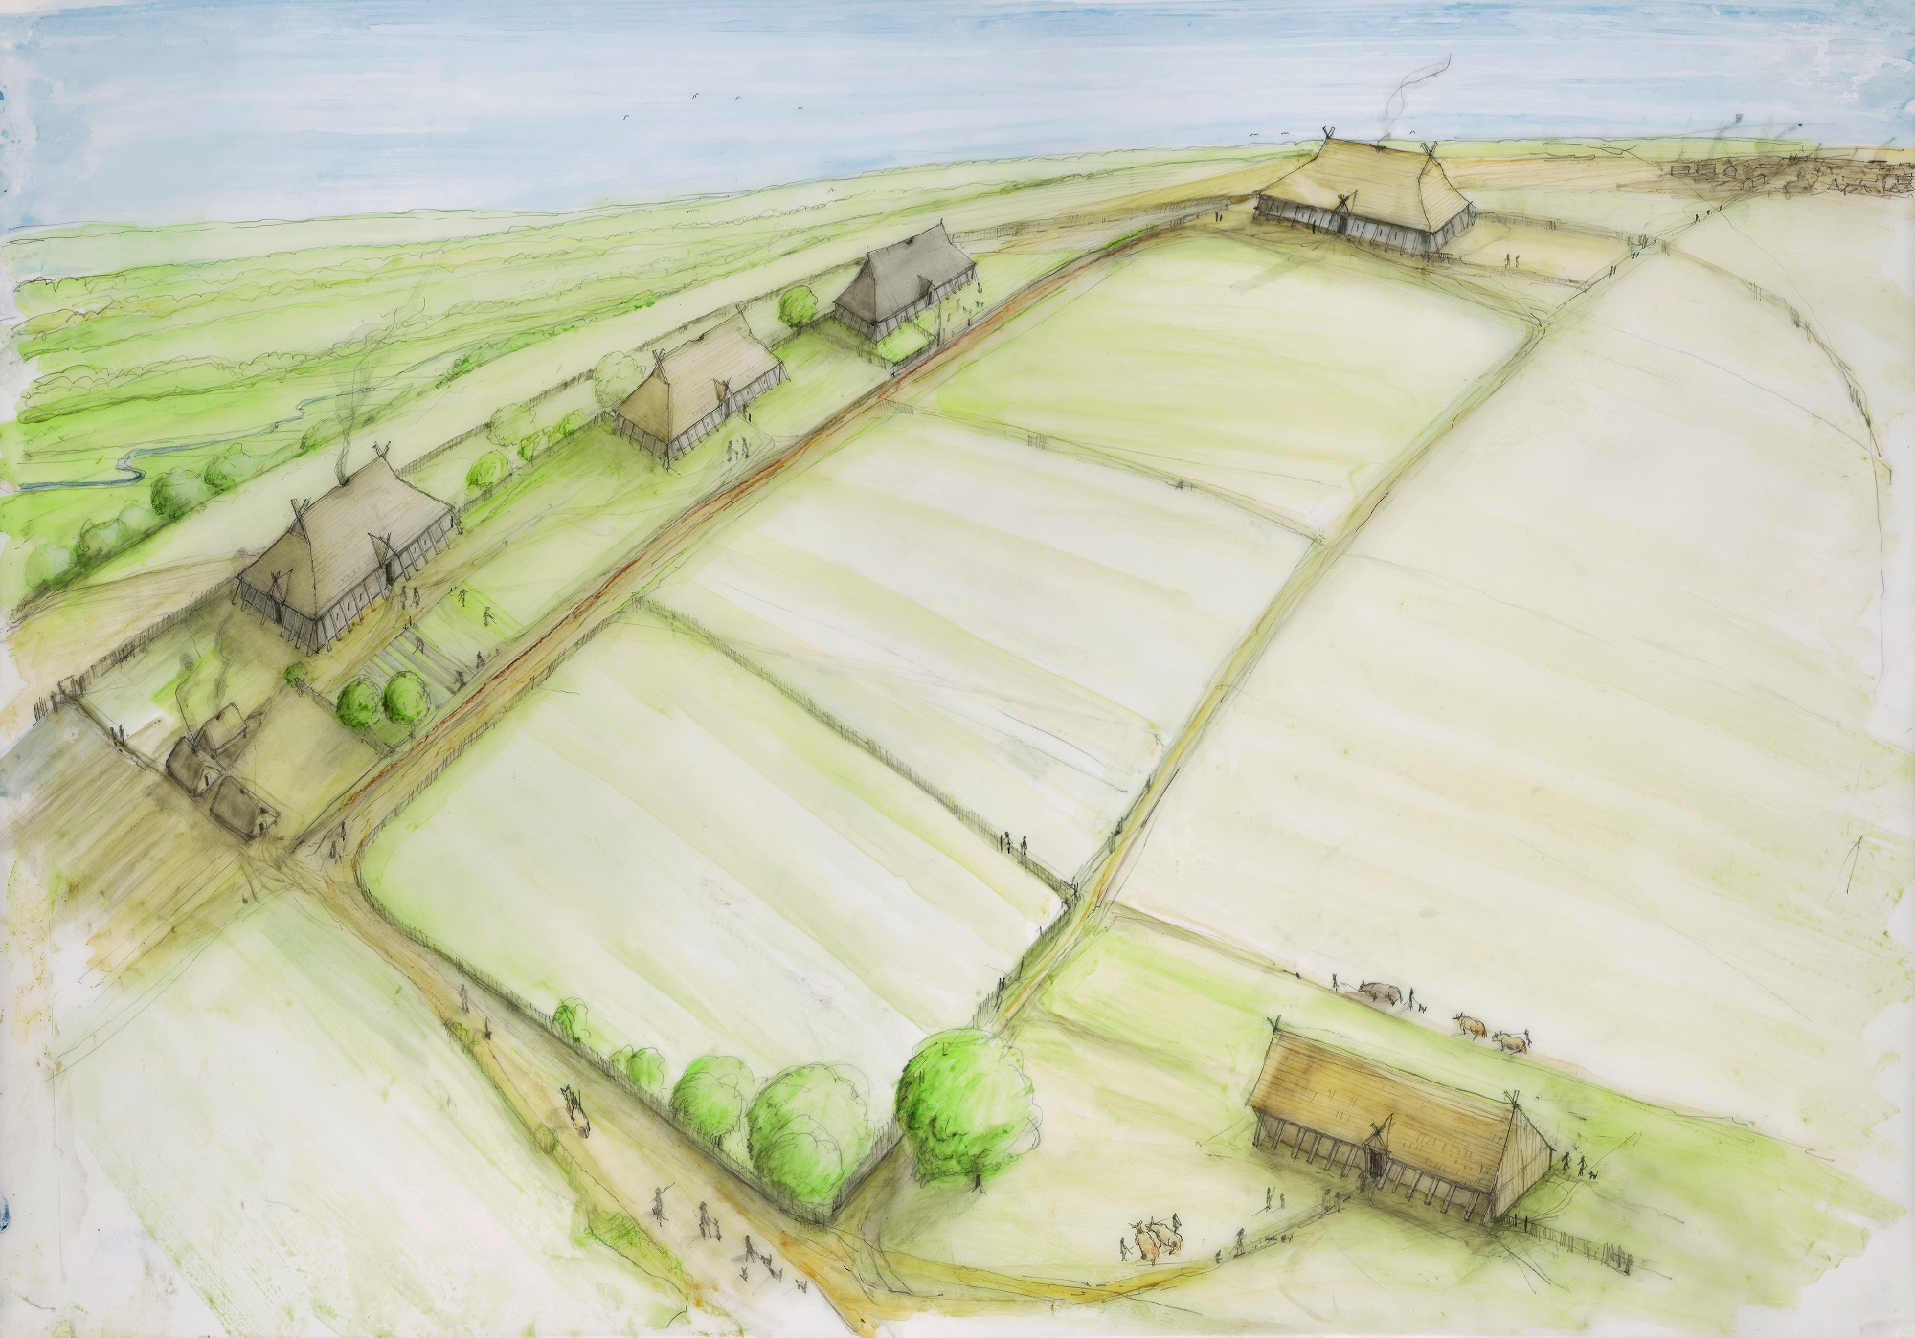
This is an artist’s impression of the settlement at Rendlesham on a quiet day. You can see the large halls in the foreground and in the background is the main settlement where the workshops would be.
The Kings and their entourage would have stayed and feasted in these halls when they visited Rendlesham.
The Kings retainers, servants and slaves and the visiting traders and craftsmen would temporarily camp in the centre. This area would be bustling with tents, market stalls and fairs that would have sprung up when the King was in residence.
By Edward Impey

Slide 32

Challenge Activities
The following slides contain some challenge activities you might like to try with your class building on the skills covered in these slides.

Slide 33

Challenge Activity: Jewellery Design
Can you design your own beads or brooch?
What colours and materials would you use?
What shape would it be?

Slide 34
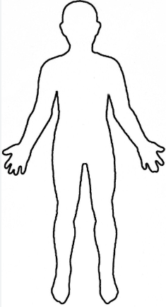
Challenge Activity: Rot or Not
Task: Draw around a friend using chalk on the playground/ draw a simple body outline on your paper/ print a simple body outline.
Can you write labels and/or draw what items of clothing or accessories you are wearing today.
Discussion: In 1,500 years time what items would survive and what would not?
How can you use your scientific knowledge of materials
to help you?
What will the archaeologists of the future know about you from the objects that survive?

Slide 35
Challenge Activity:
Being an Archaeologist
Would you like to be an archaeologist?
What aspect interests you the most and why?

Slide 36
Further Resources
Visit heritage.suffolk.gov.uk/rendlesham to find more resources including:
Virtual 360° exhibition tour
Videos on Anglo-Saxon life
Online book
Blogs and articles

Slide 37




